Slide 1
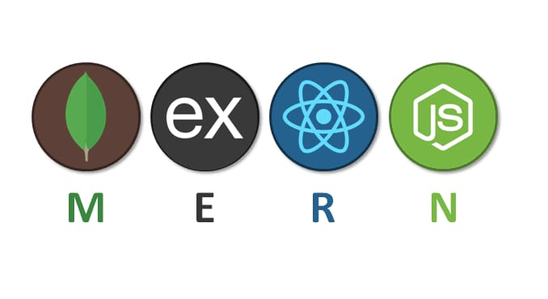
Recent Trend and Technology
MERN STACK

Slide 2
Prequisties for MERN stack
Html
Css
Javascript
Knowledge of database

Slide 3
Introduction
MERN stands for MongoDB,Express,React, Node, after the four key technologies that make up the stack that is used for easier and faster deployment of fullstack web applications.
MongoDB- document database
Express(.js)-Node.js web framework
React(.js)-a client side javascript library
Node(.js)- the premier Javascript web server

Slide 4
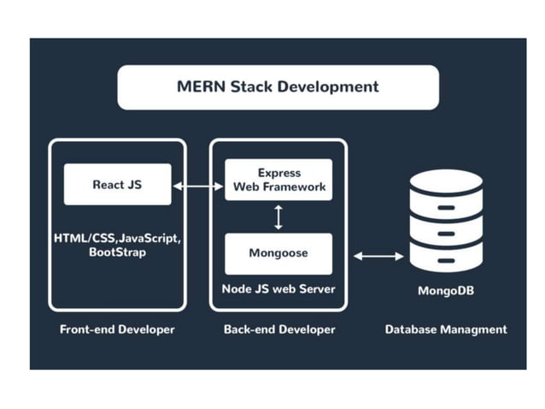

Slide 5
How does MERN stack work?
The MERN architecture allows you to easily construct a 3 tier architecture (Frontend, Backend,Database) entirely using Javascript and JSON.

Slide 6

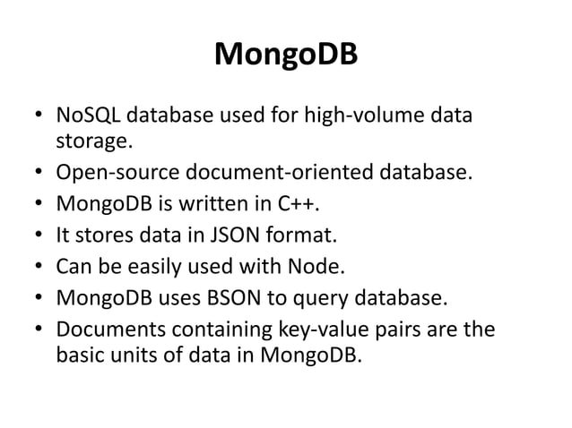

Slide 7
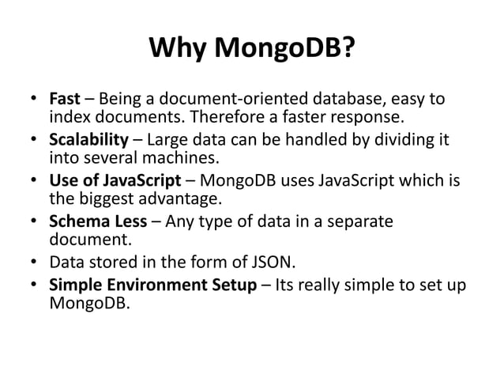

Slide 8
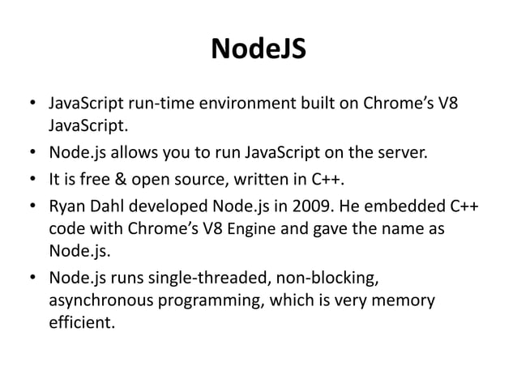

Slide 9
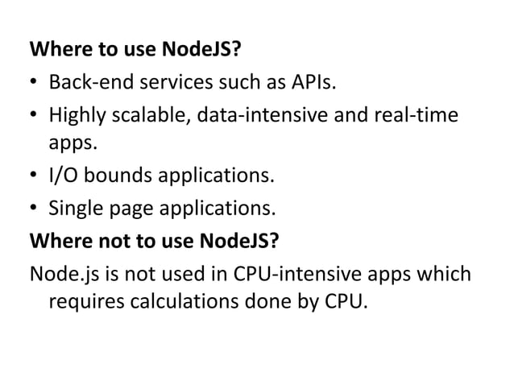

Slide 10
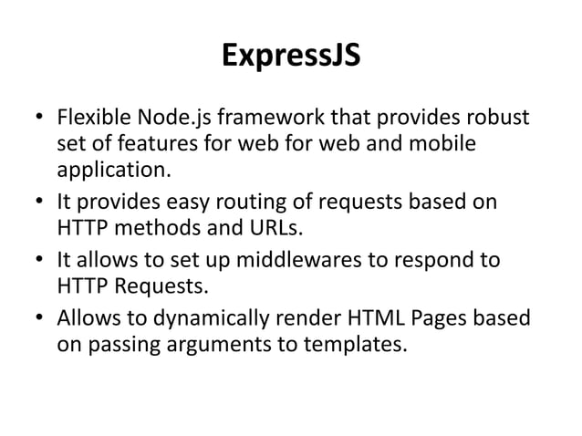

Slide 11
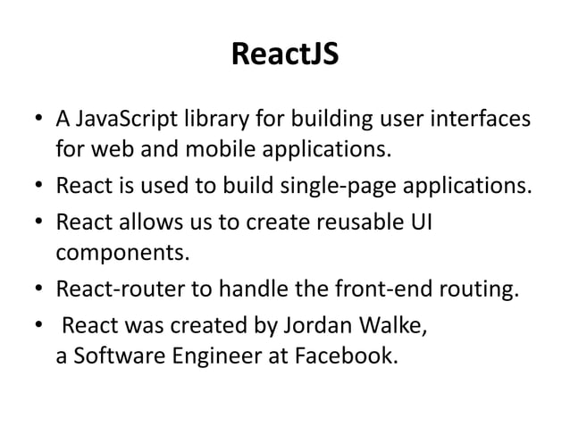

Slide 12
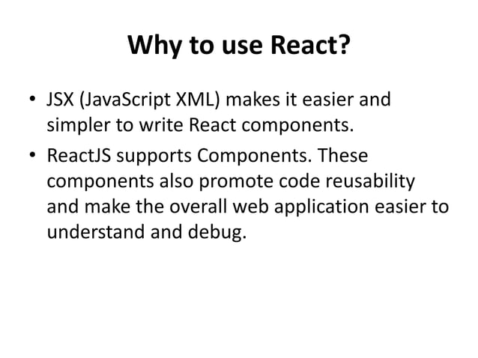

Slide 13
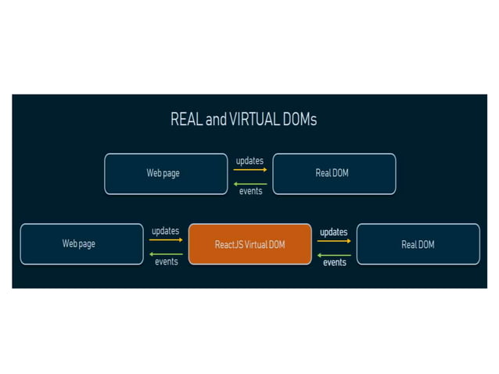

Slide 14
THANK YOU!

